Slide 1





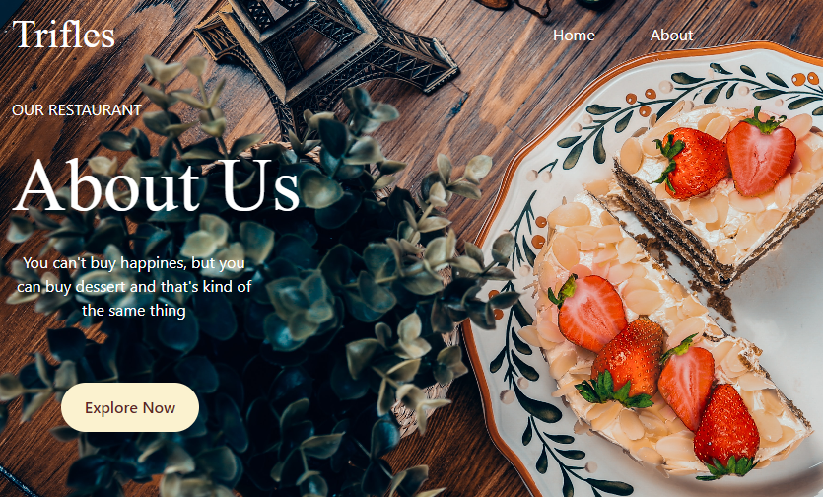


Local business website
Trifles
named
restaurant
Home Page
About Page

Slide 2






Used technologies

Slide 3


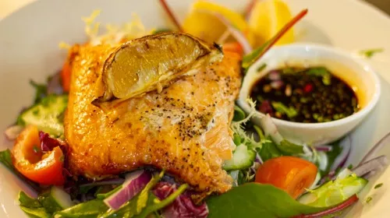


Why choose Trifles restaurant?
Delicious Food
Expert Chefs
Friendly People
Parties

